Slide 1



Enhancing CBRNe Security through Artificial Intelligence: Detection, Simulation, and
Decision-Making
Andrea Malizia^{1,2}, Luca Martellucci^{2,3}, Alessandro Puleio ^{2,3},
Riccardo Rossi^{2,3}, Alba Iannotti^{2,3,4}, Riccardo Quaranta^{1,2,3},
Colomba Russo^{2,3,4}, Daniele Di Giovanni^{1,2}, Grace P. Xerri^{2,3},
Gabriele Giuga^{2,3}, Sabrina Rao^{1,2} and Pasquale Gaudio^{2,3}
1. Department of Biomedicine and Prevention, University of Rome Tor Vergata (Italy)
2. International Master Courses in Protection against CBRNe events, University of Rome Tor Vergata (Italy)
3. Department of Industrial Engineering, University of Rome Tor Vergata (Italy)
4. HESAR s.r.l.s, (Italy)
The EU CBRN Risk Mitigation Centres of Excellence Initiative
10th International Meeting of the National Focal Points
14-15 May 2025, Egmont Palace – Brussels (Belgium)

Slide 2

Who am I?
PROF. Andrea malizia
Associate professor of nuclear measurements and instrumentations
Director of the 2 International master courses in protection against CBRNe events (First and second level)
Education
Experience
2003
Bachelor Degree in Environmental Engineering
2010 - 2012
Postdoc fellow in Physics
2005
Master Degree in Environmental Engineering
2012 - 2014
Senior Researcher in Physics
2010
Ph.D. in Quantum Electronics and Plasma Physics
2014 - 2019
Assistant Professor in Physics
2011
M.Sc. in “Protection Against CBRNe events” (2nd Level)
Assistant Professor in Nuclear Measurements and Instrumentation
2019 - 2022
2017
Ph.D. in Industrial Engineering
2022 - Today
Associate Professor in Nuclear Measurements and Instrumentations and Director of the 2 CBRNe Master Courses
Department of Biomedicine and Prevention & School of Engineering
University of Rome Tor Vergata (Italy)

Slide 3
Agenda
Objectives
Introduction
AI-CBRN Integration points
Impact Stories – Seven AI Use Cases
AI – Communication
Risk, Governance and Responsible AI
CBRN Threat Landscape
Conclusion

Slide 4
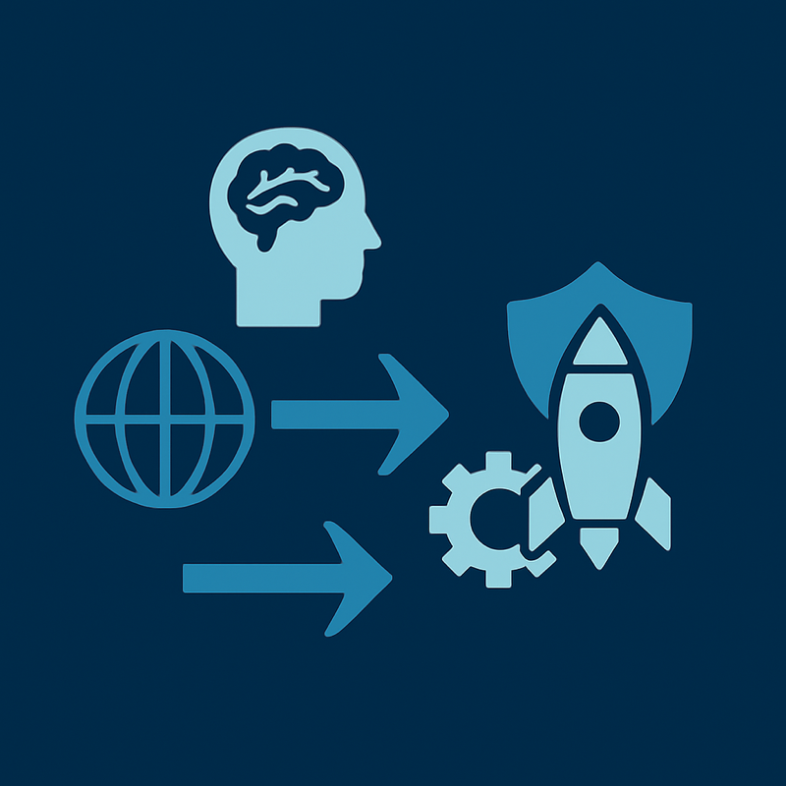
Objectives
The objectives of this presentation are:
Provide an overview of CBRNe-AI-related risks
Present potential AI applications to enhance CBRNe safety and security
Share some case studies and the key lessons learned
Explore future developments and opportunities

Slide 5

Introduction
WHERE WE ARE NOW?
The CBRN Threat Landscape is Evolving
Chemical: AI can accelerate toxic molecule design.
Biological: AI reduces barriers to bioweapon creation.
Radiological/Nuclear: AI creates new risks in nuclear systems and security.
Dual-Use Challenge:
AI advances both defense and offense simultaneously.

Slide 6
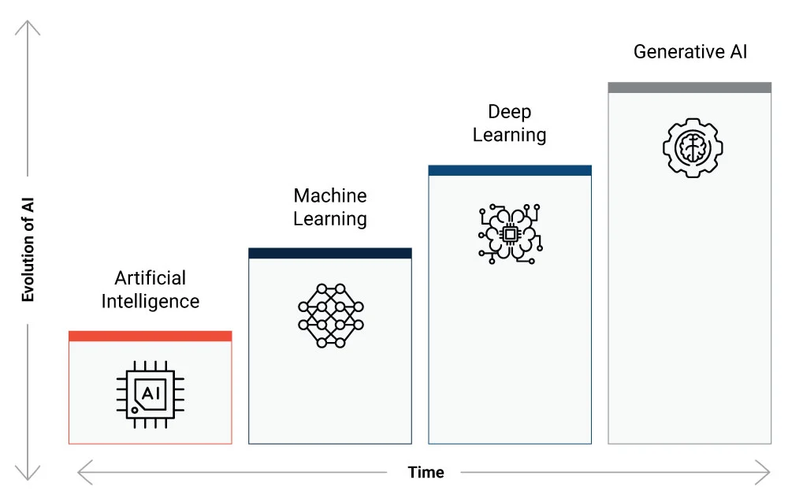
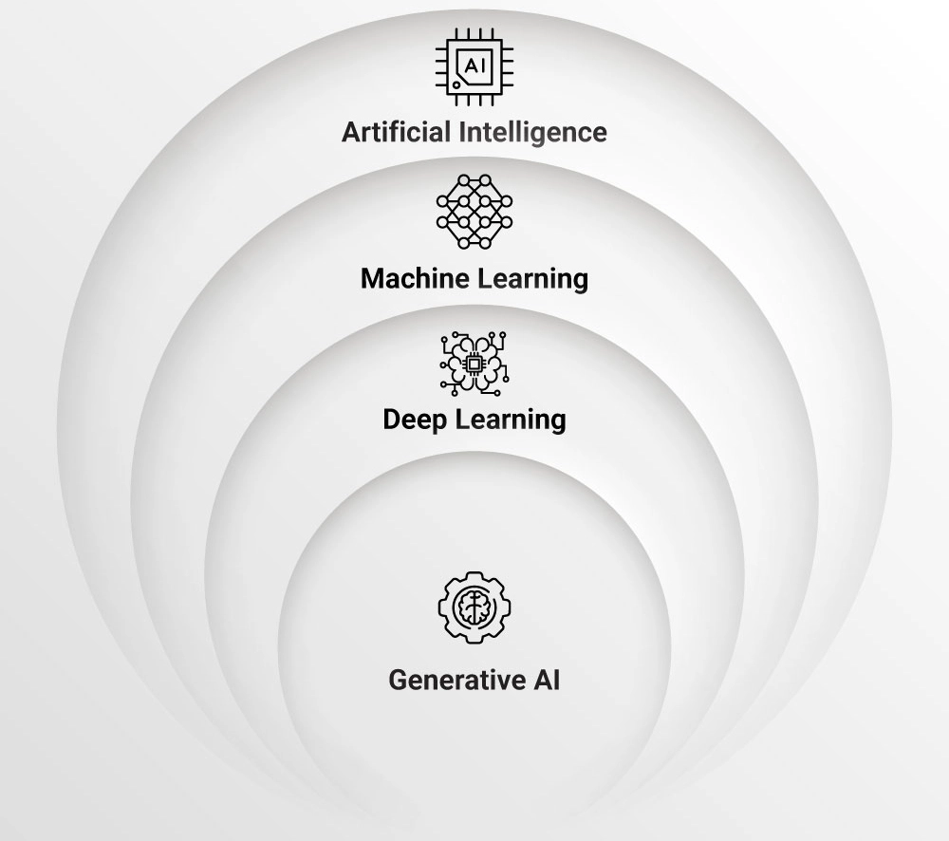
Introduction
WHAT’S AI?
https://synoptek.com/insights/it-blogs/data-insights/ai-ml-dl-and-generative-ai-face-off-a-comparative-analysis/

Slide 7
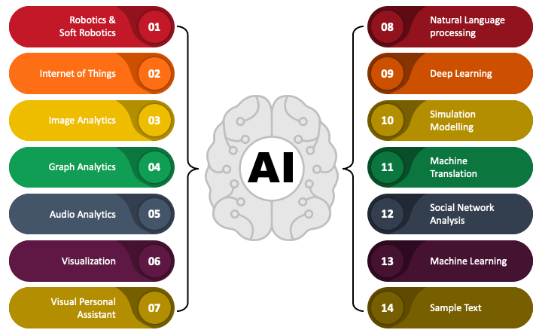
Introduction
POSSIBLE APPLICATIONS for AI
https://www.sketchbubble.com/en/presentation-applications-of-ai.html

Slide 8
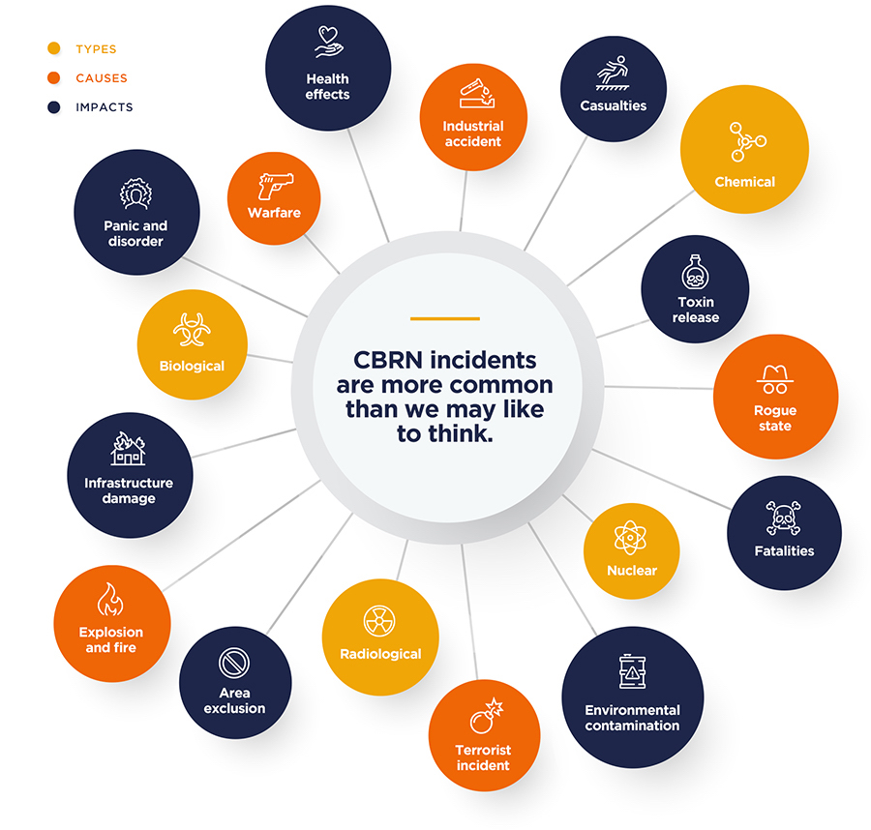
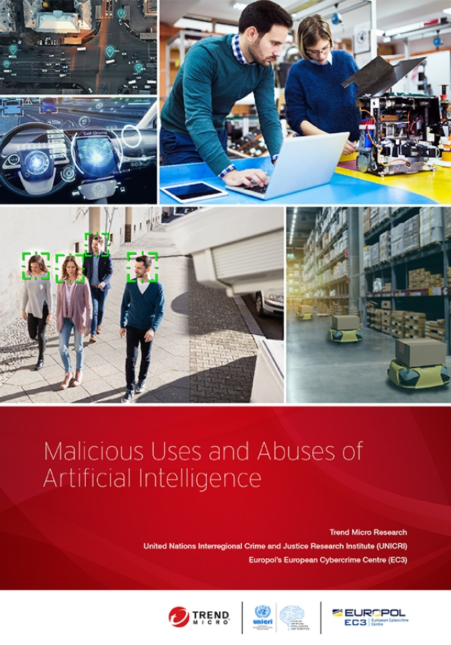
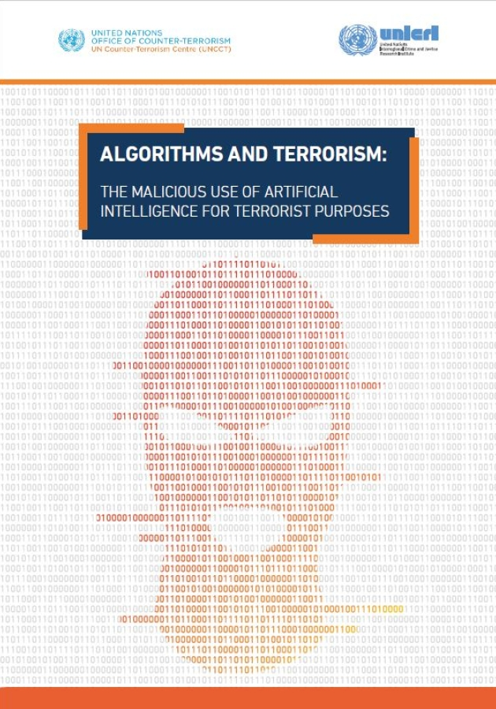
CBRN Threat Landscape
https://unicri.org/node/3278
https://unicri.org/News/Algorithms-Terrorism-Malicious-Use-Artificial-Intelligence-Terrorist-Purposes
https://www.riskaware.co.uk/insight/quick-guide-to-cbrn-threats-response-solutions/

Slide 9
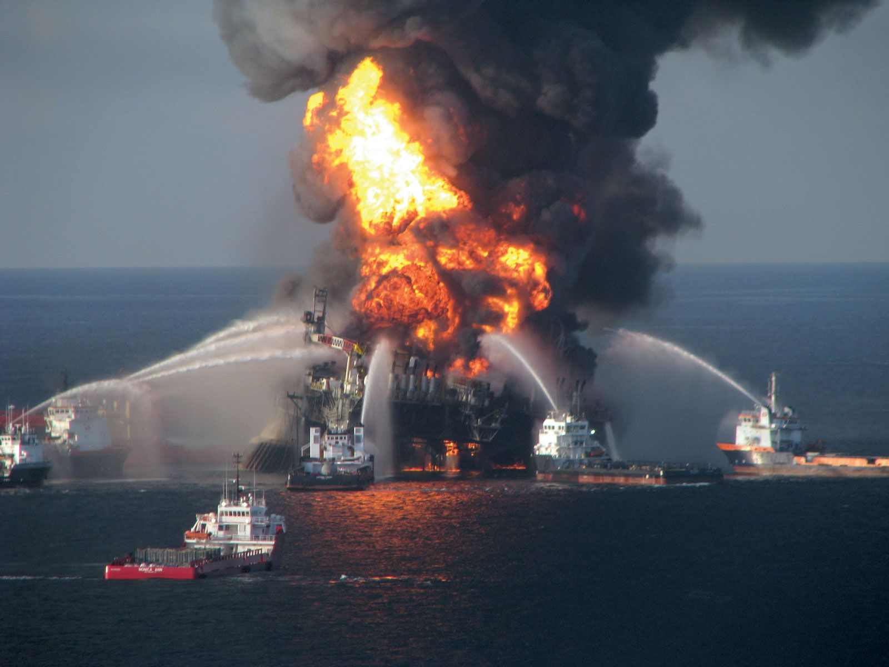
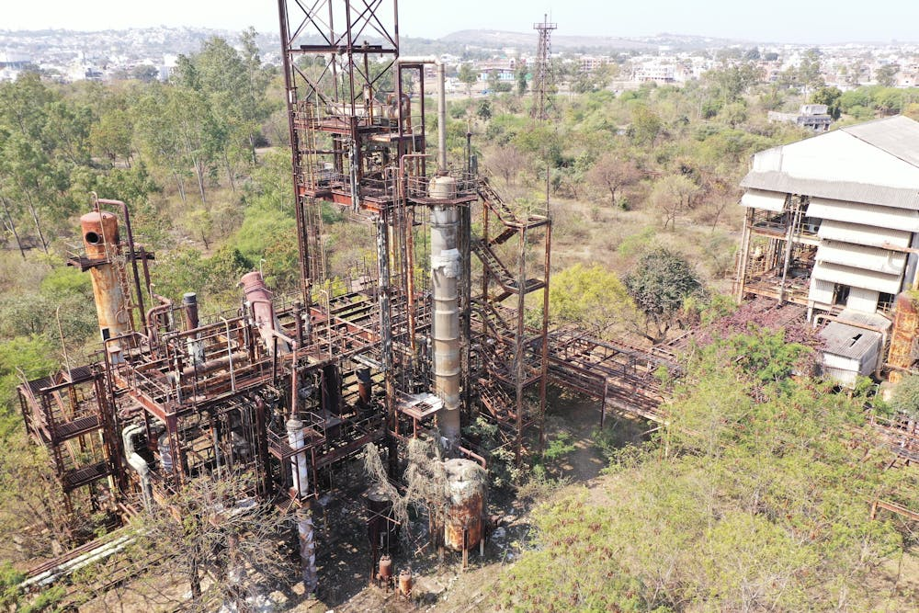
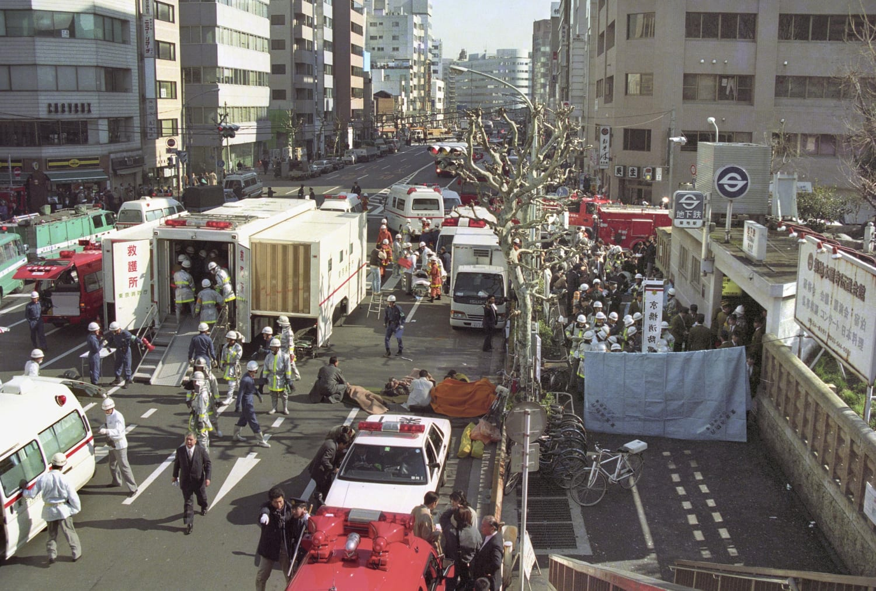
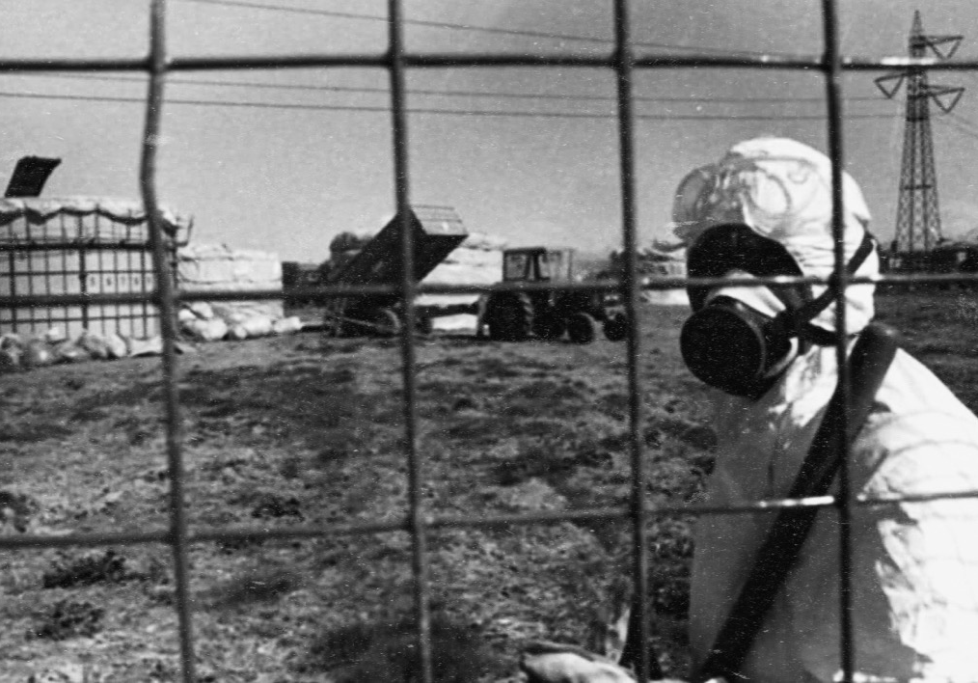
C Threat Landscape
Bhopal Gas Tragedy (1984, India)
Methyl isocyanate leak → Mass casualties, chronic illnesses (respiratory diseases, cancer).
Economic displacement and psychological trauma.
https://www.sciencedirect.com/science/article/pii/0277953688903061
Seveso Disaster (1976, Italy)
Dioxin release → Increased cancers, reproductive disorders, and skin diseases.
Long-term socio-economic damage.
https://www.sciencedirect.com/science/article/pii/S0160412018313928?via%3Dihub
Tokyo Sarin Attack (1995, Japan)
Nerve agent exposure → Deaths, PTSD, urban vulnerability.
Highlighted need for early detection sensors.
https://onlinelibrary.wiley.com/doi/10.1111/j.1553-2712.1998.tb02470.x
Deepwater Horizon Oil Spill (2010, USA)
Exposure to toxic chemicals → Cancer risk, endocrine disruption.
Severe mental health impacts due to compounded disasters.
https://link.springer.com/article/10.1007/s40572-016-0119-7

Slide 10
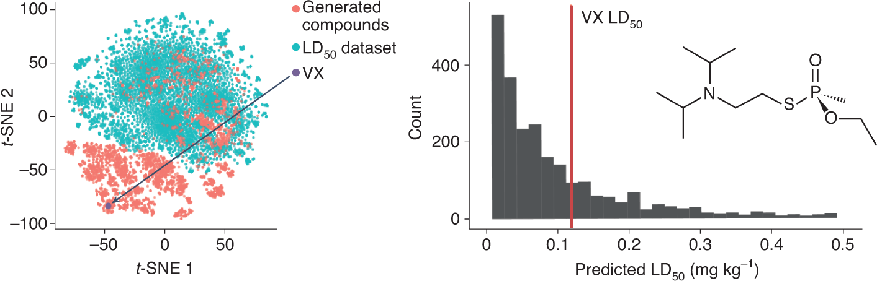
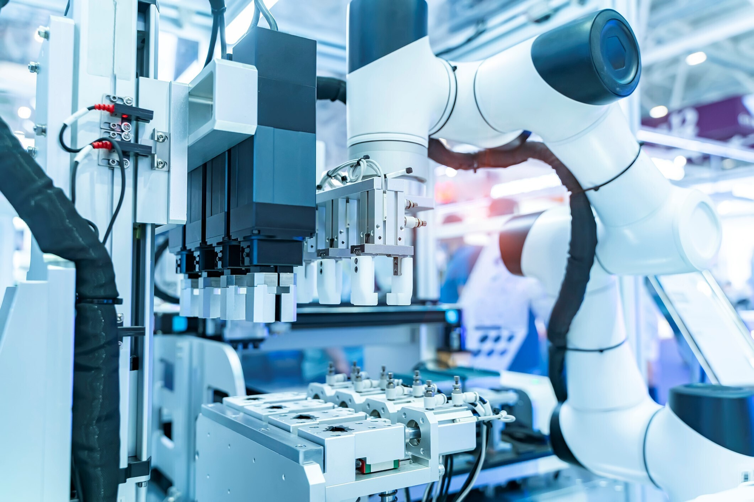


C-AI Threat Landscape
AI-Designed Toxic Compounds (2022 – Dual-Use Drug Discovery Case)
In 2022, researchers led by Fabio Urbina demonstrated that an AI model, initially developed for drug discovery, could be repurposed to generate approximately 40,000 potentially lethal molecules, including structures like VX nerve agent, within six hours.
Risks: designing chemical weapons with 0 expertise, new challenges for detection and regulation.
https://www.nature.com/articles/s42256-022-00465-9
AI-Controlled Autonomous Laboratories
Important informatics firms have now a platform integrating AI, cloud computing, and robotics to automate chemical synthesis processes, allowing remote execution of chemical reactions with minimal human intervention.
Risks: Potential misuse or hacking of autonomous labs, unintended production of toxic compounds.
https://pubs.acs.org/doi/10.1021/jacsau.1c00303
AI-Enhanced Cyberattacks on Chemical Plants
The 2017 Triton malware attack targeted the safety systems of a Saudi Arabian petrochemical plant, aiming to disable safety instrumented systems and potentially cause physical harm.
Risks: AI-driven cyberattacks, intentional toxic releases, and explosions.
https://www.ic3.gov/CSA/2022/220325.pdf
AI-Generated Chemical Disinformation
AI technologies can create realistic fake news, videos, and images, potentially simulating chemical spills or attacks to spread disinformation.
Risks: Public panic, erosion of trust, and hindering effective crisis management.
https://www.dhs.gov/sites/default/files/2025-01/25_0110_st_impacts_of_adversarial_generative_aI_on_homeland_security_0.pdf

Slide 11
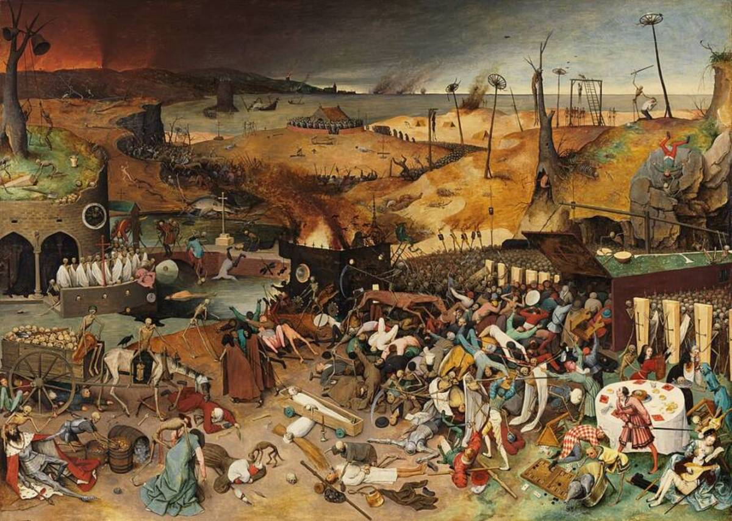
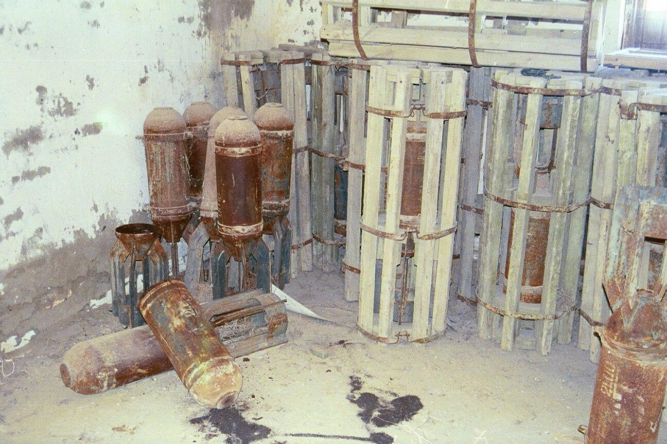
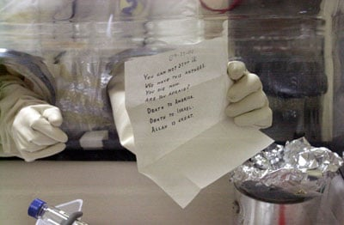
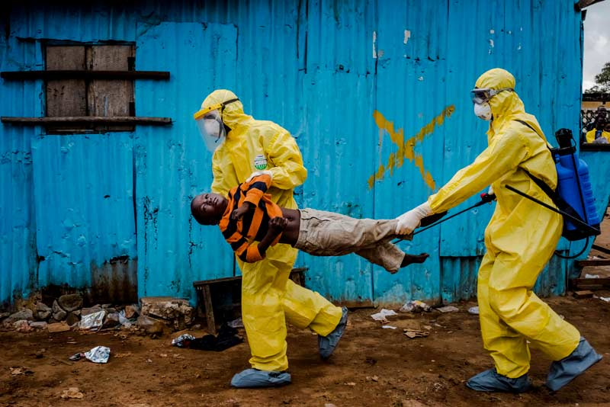
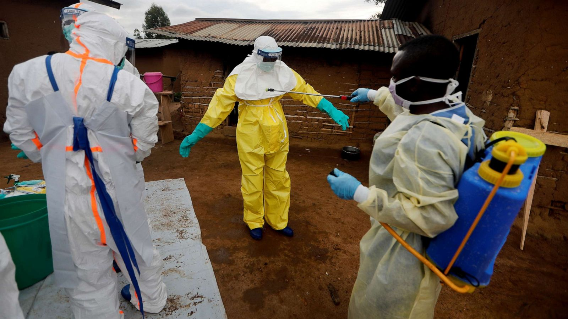

B Threat Landscape
Siege of Caffa (1346, Crimea)
During the siege of the Genoese city of Caffa (modern-day Feodosia, Crimea), Mongol forces reportedly catapulted plague-infected corpses over the city walls, infecting inhabitants and contributing to the spread of the Black Death into Europe
Demonstrated how pathogens could be weaponized long before modern microbiology.
https://www.embopress.org/doi/full/10.1038/sj.embor.embor849
Aral Smallpox Incident (1971, Kazakhstan)
A biological weapons test in the Aral Sea led to a smallpox outbreak in Aralsk, Kazakhstan. Ten people were infected, and three died.
Risk of clandestine BWs programs and accidental releases
https://www.nonproliferation.org/wp-content/uploads/2016/10/op9.pdf
Anthrax Letters (2001, USA)
5 casualties, 17 infected
First modern bioterrorist attack on U.S. soil reforming biodefence strategies
https://link.springer.com/chapter/10.1007/978-1-4471-2927-1_46
Ebola outbreaks (2014-2020, West Africa and DRC)
2014–2016 West Africa: Over 28,000 cases and 11,000 deaths, overwhelming local health systems.
2018–2020 DRC: ~3,400 cases, complicated by conflict and mistrust of responders.
https://onlinelibrary.wiley.com/doi/10.1155/2015/769121
Spanish Flu and COVID-19 pandemics (World)
Spanish Flu (1918–1920): Infected ~500 million people, causing over 50 million deaths.
COVID-19 Pandemic (2019–Present): Over 6.9 million confirmed deaths globally as of 2023, with massive societal and economic impacts.
https://onlinelibrary.wiley.com/doi/10.1111/ene.16312

Slide 12
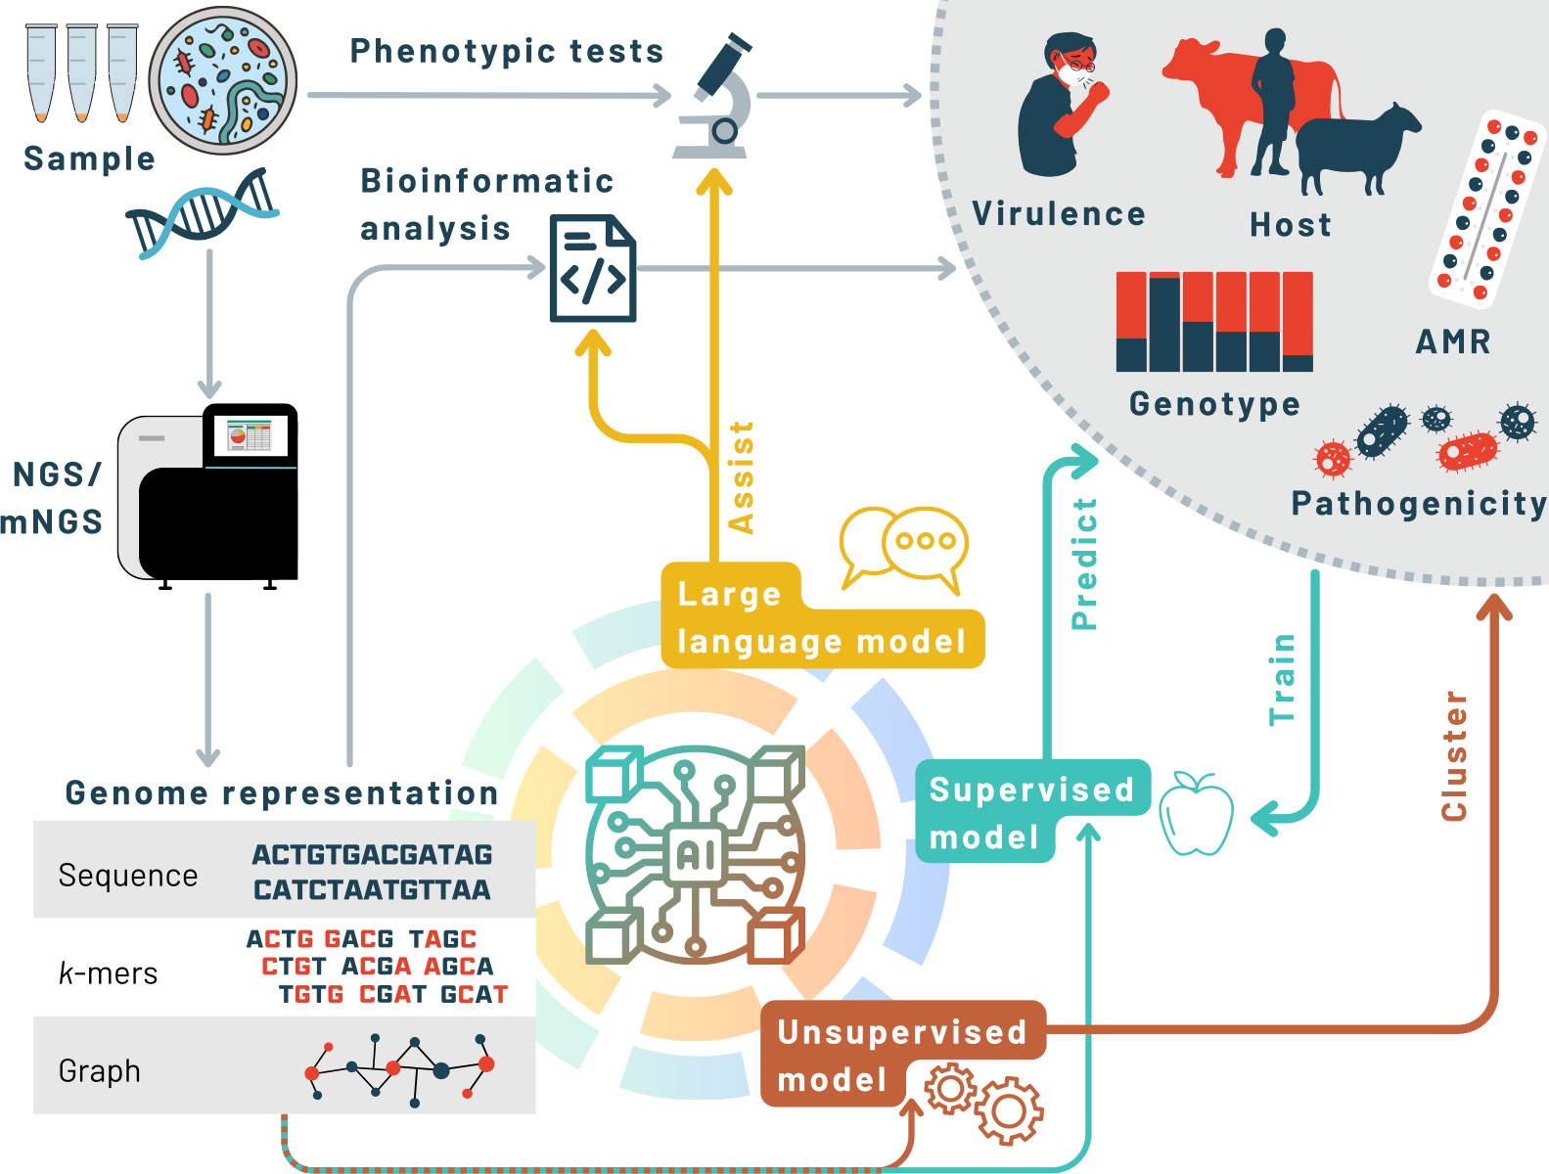
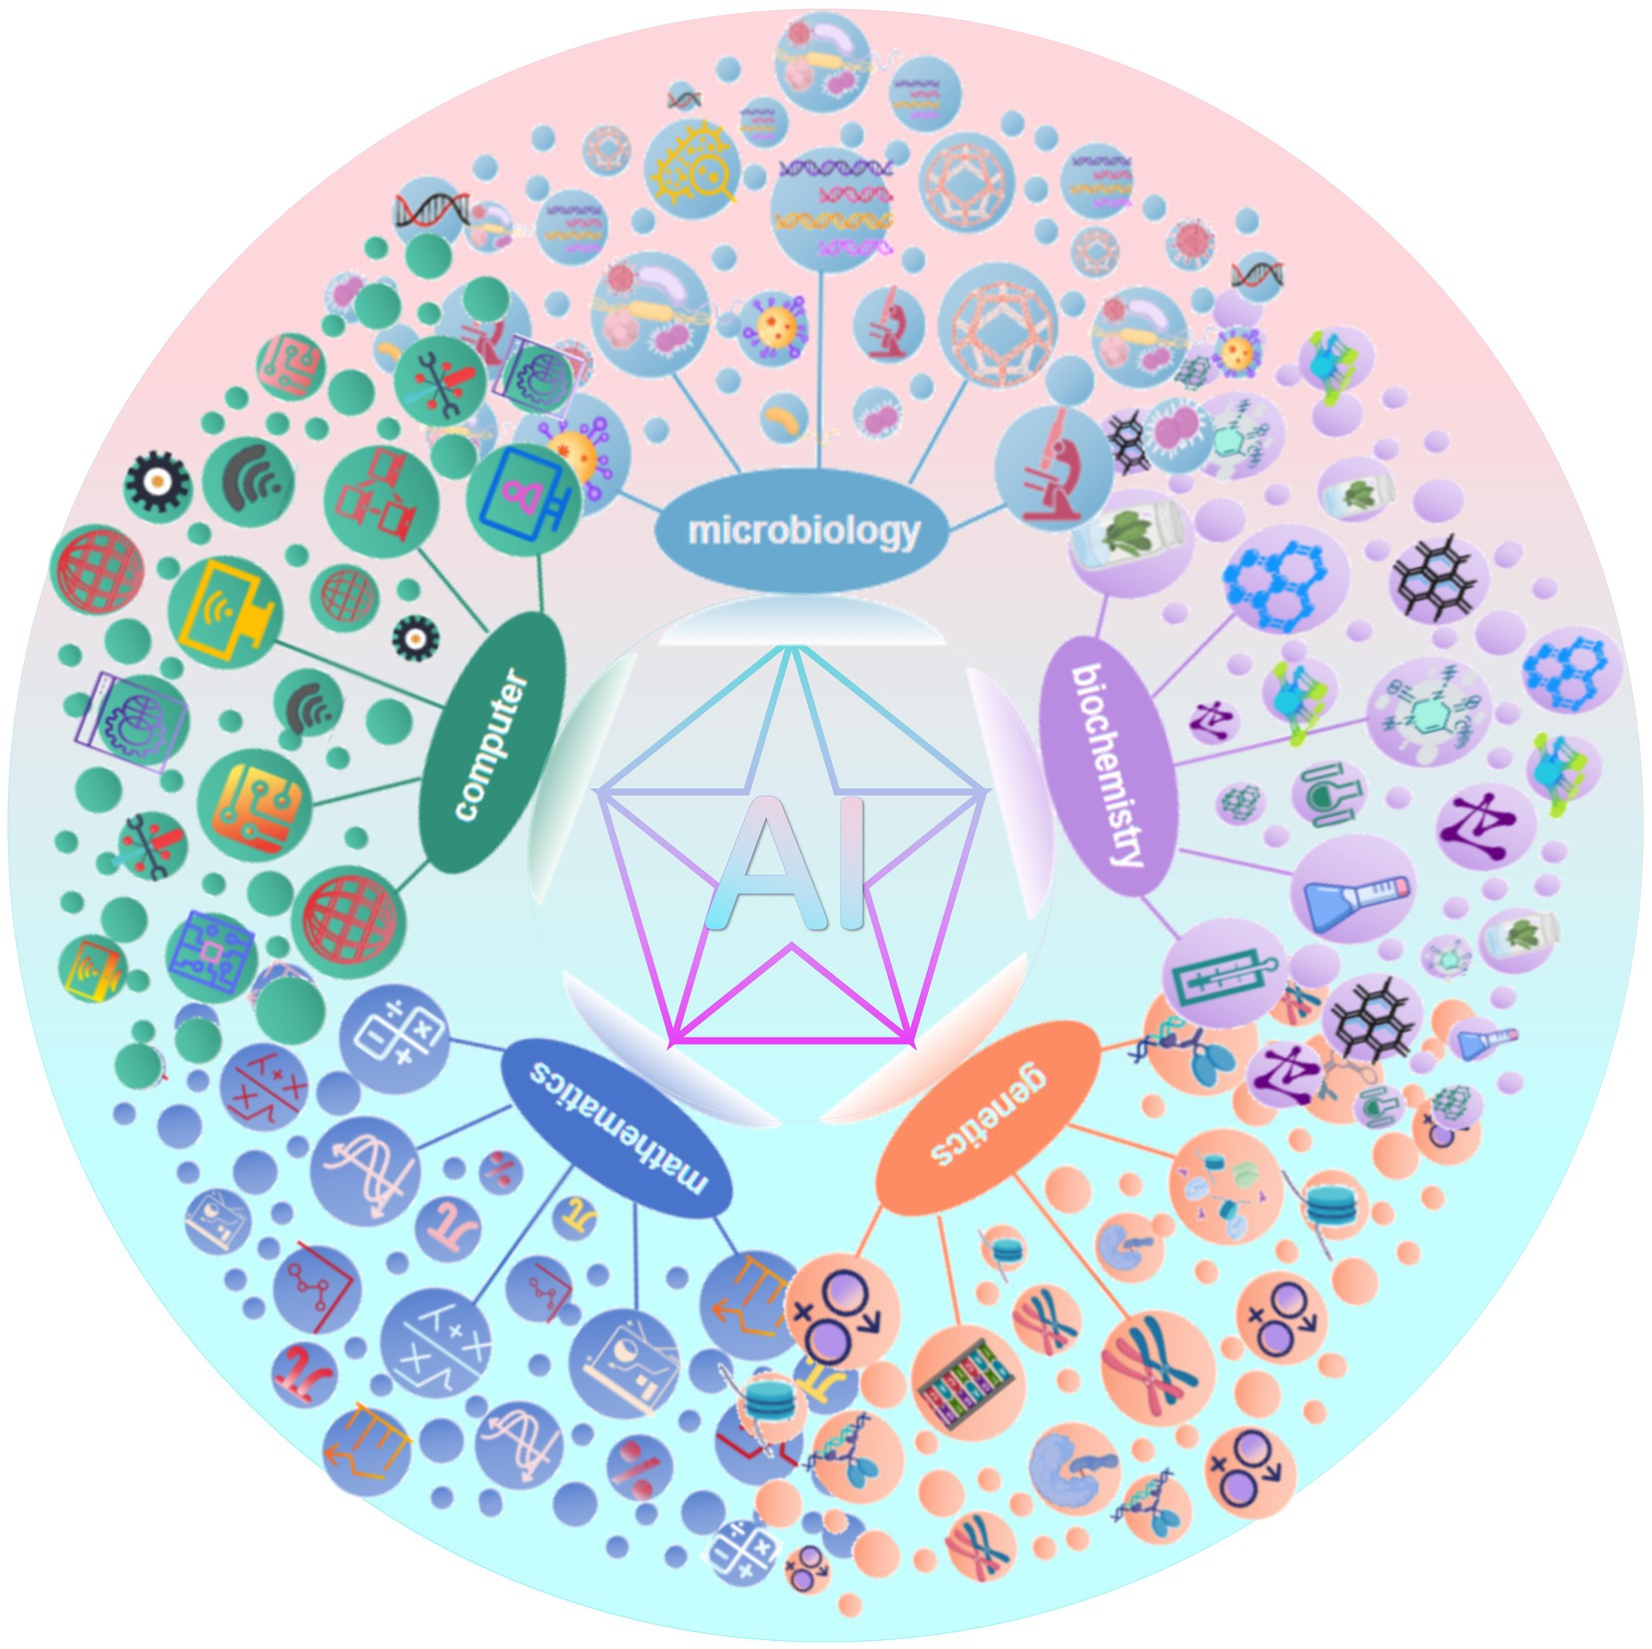
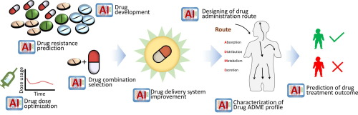
B-AI Threat Landscape
AI-Assisted Design of Pathogens
AI models can be easily redirected from beneficial to harmful purposes with minimal changes (Urbina again)
There’s a critical need for ethical guidelines and oversight in AI research to prevent misuse.
https://www.embopress.org/doi/full/10.1038/s44319-024-00124-7
AI Outperforms Virologists in Laboratory Tasks
A recent study introduced the Virology Capabilities Test (VCT) to assess AI models’ proficiency in virology lab tasks. OpenAI’s o3 model achieved a 43.8% accuracy rate, outperforming 94% of expert virologists, who averaged 22.1%
Risks: AI systems can surpass human experts in specialized tasks
https://arxiv.org/abs/2504.16137?utm_source=chatgpt.com
Dual-Use Nature of AI in Life Sciences
AI-DUAL-USE dilemma
https://www.nature.com/articles/s42256-022-00511-6
AI-Enabled Democratization of Bioweapon Knowledge
Research has shown that large language models (LLMs) can provide detailed instructions on creating biological weapons, making such knowledge accessible to individuals without specialized expertise.
Risks: Misuse of LLMs
https://www.nature.com/articles/s41597-024-03099-1

Slide 13
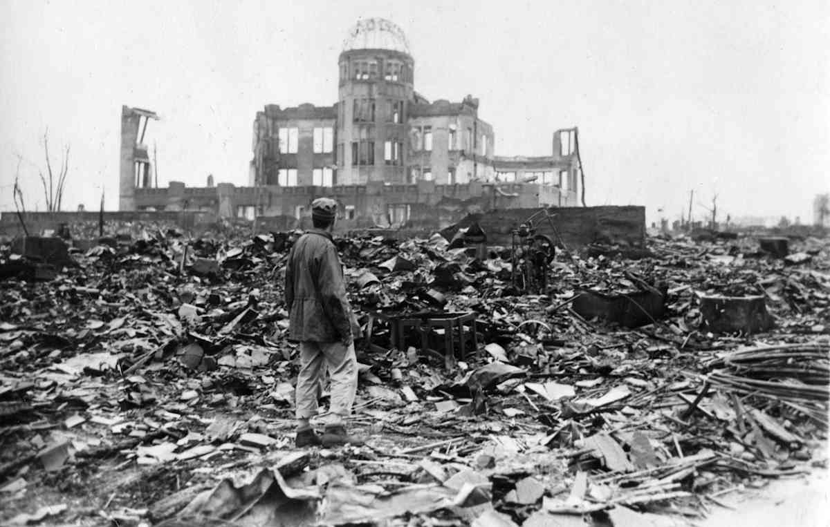
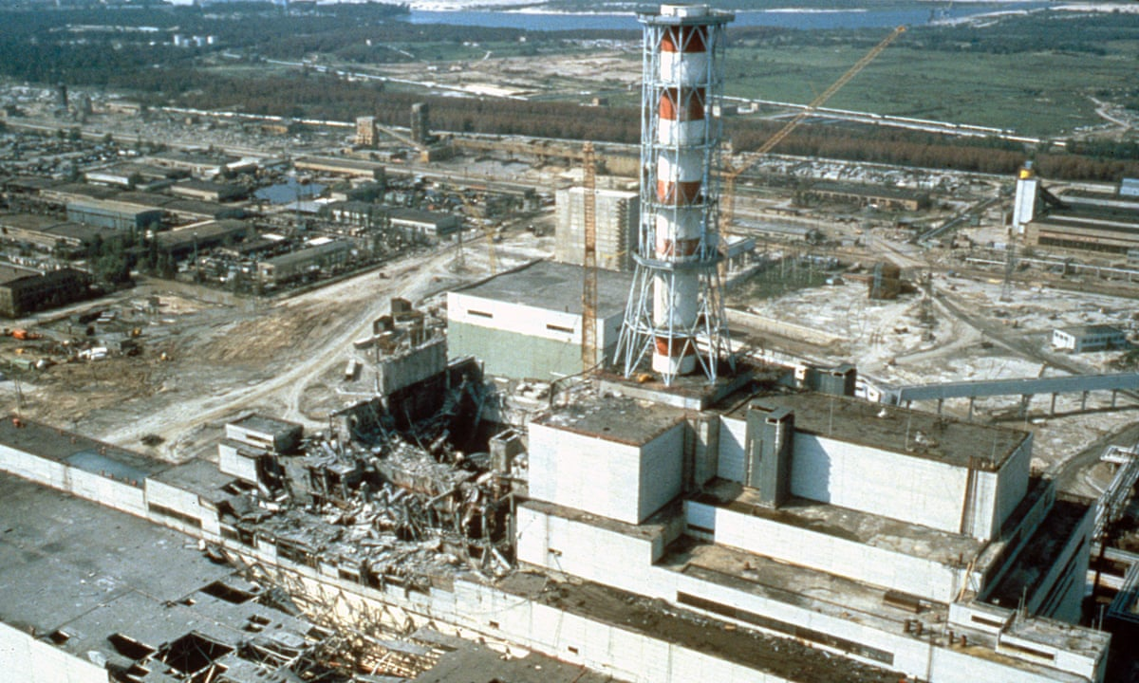
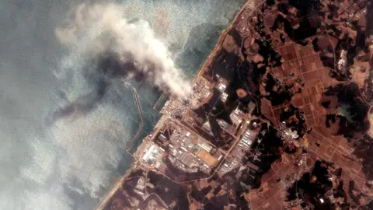
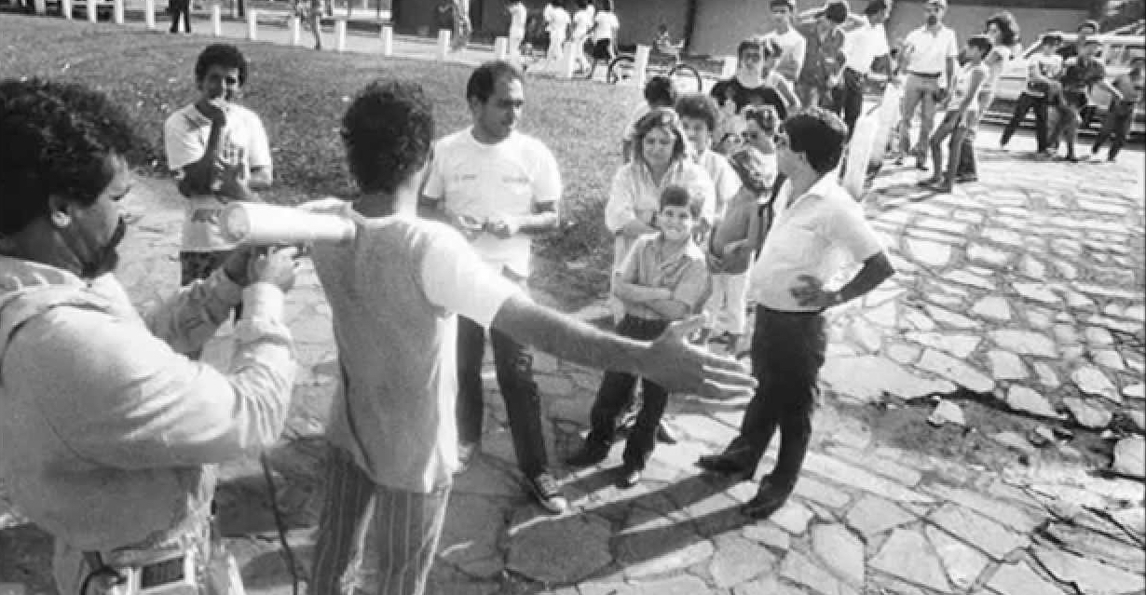
RN Threat Landscape
Hiroshima and Nagasaki (1945, Japan)
The first and only use of nuclear weapons in conflicts showed the devastating immediate and long-term effects.
creation of the Treaty on the Non-Proliferation of Nuclear Weapons (NPT).
https://www.tandfonline.com/doi/full/10.1080/25751654.2019.1681226
Chernobyl Disaster (1986, Ukraine)
Reactor 4 exploded during a safety test at the Chernobyl Nuclear Power Plant in Ukraine. The event released massive radioactive contamination across Europe.
The worst nuclear accident in history in terms of radiation released and human/environmental impact.
https://www.sciencedirect.com/science/article/pii/S0936655511005346?via%3Dihub
Fukushima Daiichi Nuclear Disaster (2011, Japan)
Nerve agent exposure → Deaths, PTSD, urban vulnerability.
Sparked global debate on the future of nuclear energy.
www.iieta.org/journals/ijsse/paper/10.18280/ijsse.110421
Goiânia Radiological Accident (1987, Brazil)
4 deaths, 249 people contaminated, 100,000+ screened.
Highlighted critical need for radiological security in hospitals, industry, and waste sites.
https://journals.lww.com/health-physics/abstract/1991/01000/medical_and_related_aspects_of_the_goiania.2.aspx

Slide 14

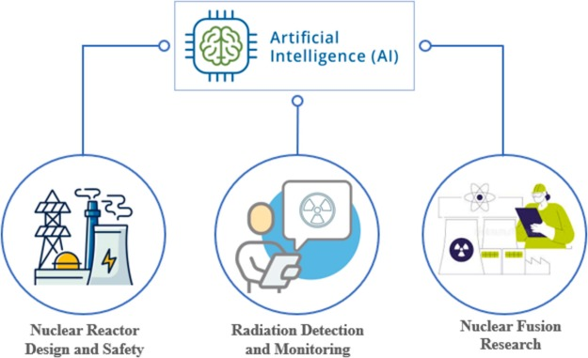
RN-AI Threat Landscape
AI in Nuclear Command and Control Systems
A study by the RAND Corporation explored how AI might affect the risk of nuclear war
Risks: Overdependence on AI without adequate human oversight can lead to catastrophic errors
https://www.rand.org/content/dam/rand/pubs/perspectives/PE200/PE296/RAND_PE296.pdf
AI in Nuclear Facility Safety and Operations
AI technologies are being employed to enhance the safety and efficiency of nuclear power plants, including predictive maintenance and anomaly detection.
Continuous monitoring and human oversight remain essential.
https://www.iaea.org/newscenter/news/the-future-of-atoms-artificial-intelligence-for-nuclear-applications
AI in Nuclear Threat Detection and Non-Proliferation
AI enhances the capability to detect and prevent illicit nuclear activities, but also to escape from them.
Collaboration between international agencies is necessary for effective implementation.
https://www.sciencedirect.com/science/article/pii/S0306454924000604
AI in Autonomous Weapons Systems with Nuclear Capabilities
A report by the Future of Life Institute discussed the risks associated with lethal autonomous weapons systems (LAWS), emphasizing the potential for AI-driven systems to make life-and-death decisions without human intervention
Autonomous systems can operate at speeds beyond human reaction, increasing the risk of unintended escalation.
https://brill.com/view/journals/ihls/aop/article-10.1163-18781527-bja10107/article-10.1163-18781527-bja10107.pdf?srsltid=AfmBOorrvkVRDhvH49XiJTvhjQGsrMJgBvP-e7fFhvEhiD7utW7d0aOn

Slide 15
AI-CBRN Integration points
AI is transforming risk detection, prediction, and response.
CBRNe threats are complex, fast-evolving, and data-heavy.
Human operators alone cannot keep up—AI is a critical enabler.
AI Capability | CBRNe Application Example
Anomaly Detection | Unusual sensor patterns (gas, rad levels, etc.)
Predictive Analytics | Forecast plume dispersion or disease spread
Natural Language Processing (NLP) | Interpret incident reports or crowd data
Image Recognition | Detect contamination in satellite/drone imagery
Autonomous Systems | Robots/drones for detection and intervention
“In CBRNe events, time is life.
AI gives us faster, smarter response capabilities.”

Slide 16
AI-CBRN Integration points
Integration Point | AI Role / Function
🛰️ 1. Surveillance & Early Warning | AI analyzes data from sensors, satellites, and social media to detect anomalies or emerging threats in real time.
📊 2. Decision Support | AI provides rapid situational analysis and recommends tailored response strategies for field units and command centers.
🎮 3. Simulation & Training | Generative AI creates immersive, dynamic training scenarios for CBRNe personnel (e.g., virtual drills).
🤖 4. Incident Response Automation | AI-guided robots and drones perform high-risk tasks like sampling, triage, and contaminated area mapping.
📉 5. Aftermath Assessment | AI models project contamination spread, population exposure, and long-term health/environmental impacts.

Slide 17
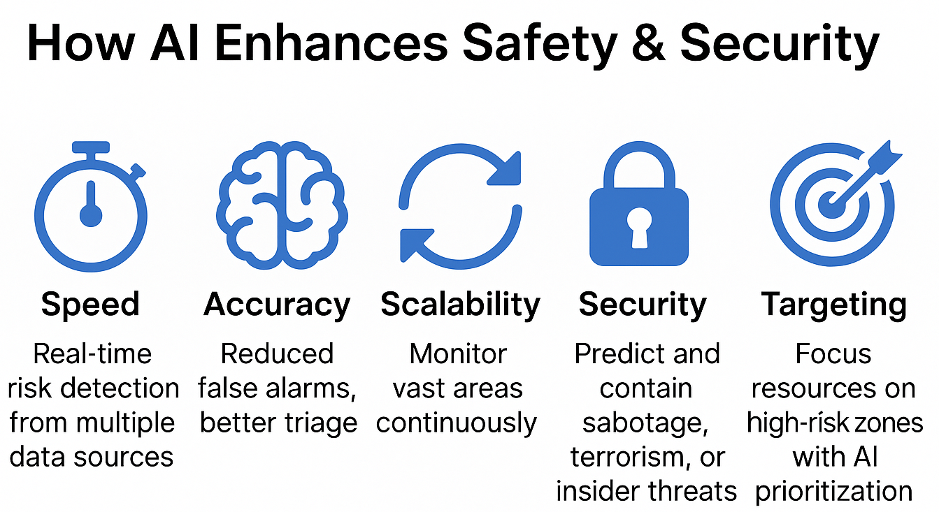
AI-CBRN Integration points

Slide 18
Impact Stories – Seven AI Use Cases
USE CASE 1: AI-Driven Safety in Chemical Facilities
KEY POINTS
Real-Time Monitoring: Implementation of AI-enhanced vision systems enables continuous surveillance of operations, promptly identifying potential hazards.
Automated Safety Violation Detection: AI systems can automatically detect safety breaches, such as unauthorized access to restricted zones or improper use of personal protective equipment (PPE).
Reduced Response Time: By providing immediate alerts, AI systems facilitate quicker responses to chemical hazards, minimizing potential risks.

Slide 19
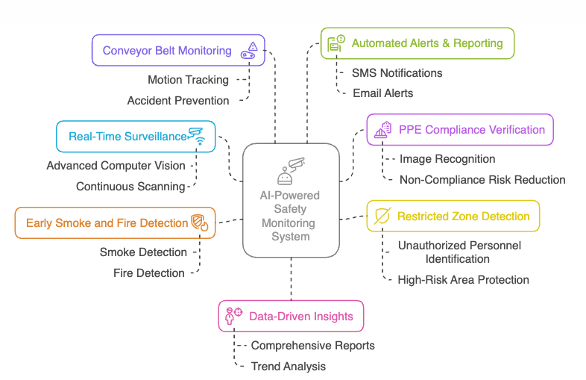
Impact Stories – Seven AI Use Cases
USE CASE 1: AI-Driven Safety in Chemical Facilities
https://surveily.com/case-studies/chemical

Slide 20
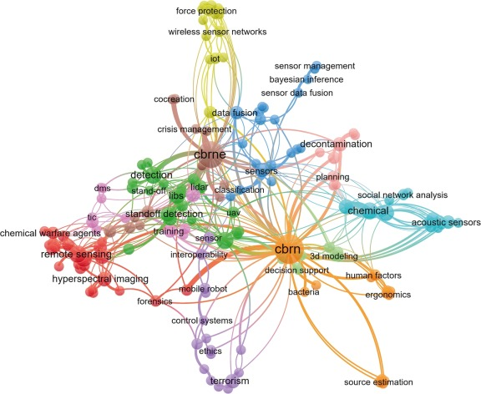
Impact Stories – Seven AI Use Cases
USE CASE 2: AI-Powered Decision Support in CBRN Incidents
KEY POINTS
  AI-Powered Decision Support Systems (DSS)
  Real-time plume modeling
  Predictive analytics for population exposure
  Visualization of spread and risk zones
  BENEFITS
  Faster decision cycles
  Better coordination between agencies
https://www.sciencedirect.com/science/article/pii/S2405844024019777

Slide 21
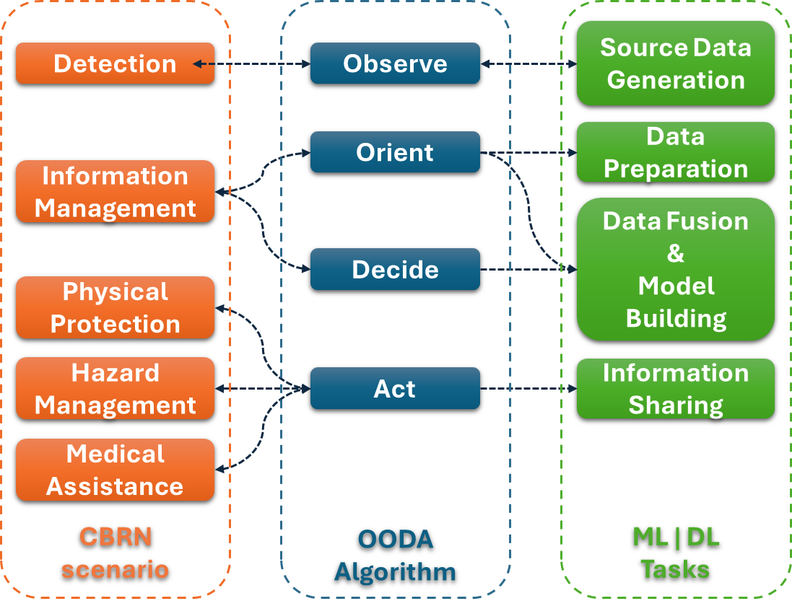
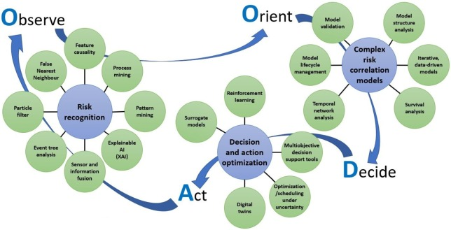
Impact Stories – Seven AI Use Cases
USE CASE 2: AI-Powered Decision Support in CBRN Incidents
  Ex. 1 - Machine learning -based decision support framework for CBRN protection
  https://www.sciencedirect.com/science/article/pii/S2405844024019777
Relationships of CBRN activities, OODA-loop steps, and ML tasks. The chart highlights the similarities of CBRN protection structure, OODA-loop, and ML solution phases by connecting the corresponding steps.

Slide 22
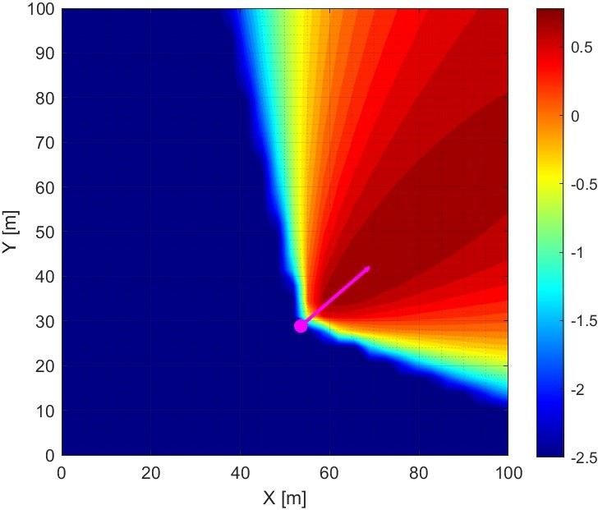
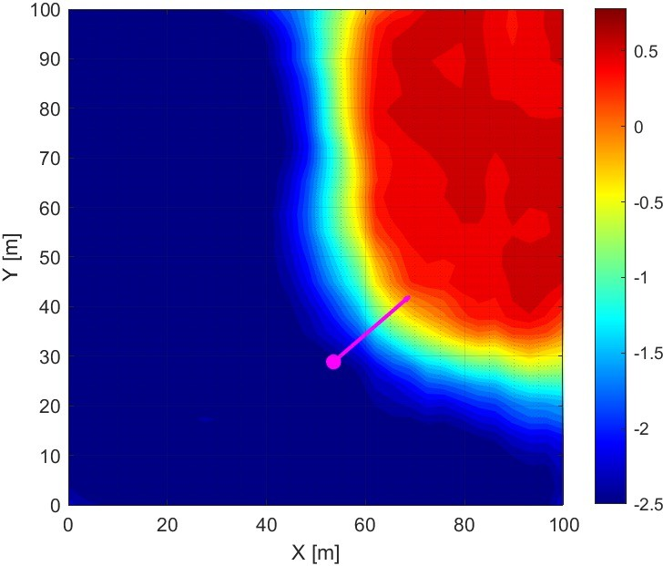
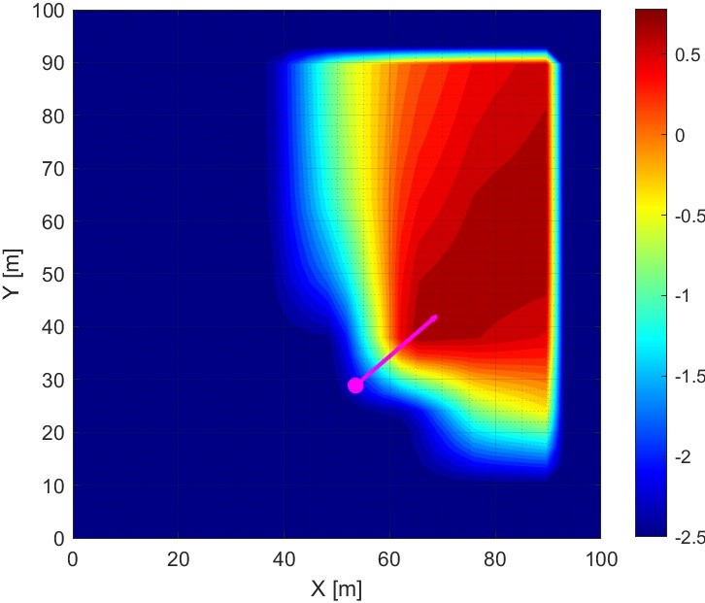
Impact Stories – Seven AI Use Cases
USE CASE 2: AI-Powered Decision Support in CBRN Incidents
  Ex. 2 – University of Rome Tor Vergata – Prof. Gaudio, Dr. Puleio, Dr. Rossi, Dr. Martellucci
Simulated Dispersion n° 236 (20 m) (Log10 scale)
Quote Disp. = 17.52 m – Ang. Wind = 49.24°
V. Wind = 3.85 ms-1
Dispersion Predicted n° 236 (20 m) (Log10 scale)
Quote Disp. = 17.52 m – Ang. Wind = 49.24°
V. Wind = 3.85 ms-1
MSE = 0.1753; R2 = 90.9%
Interpolated Dispersion n° 236 (20 m) (Log10 scale)
Quote Disp. = 17.52 m – Ang. Wind = 49.24°
V. Wind = 3.85 ms-1
R2 = 43%
Gride quote [m] | Average MSE (Std) [a.u.] | Average R² (Std) [%] | Training Time [hh:mm:ss] | Prediction Time [sec]
2 | 0.0712 (0.0499) | 94.609% (3.838%) | 01:52:18 | 0.00978 “Prediction time on a standard laptop and not on real-time hardware (e.g., FPGA, etc.). In that case, we can even go below 1 ms
20 | 0.0837 (0.0456) | 93.816% (3.973%)
50 | 0.0567 (0.0377) | 95.740% (2.726%)
https://doi.org/10.1117/12.2685858

Slide 23
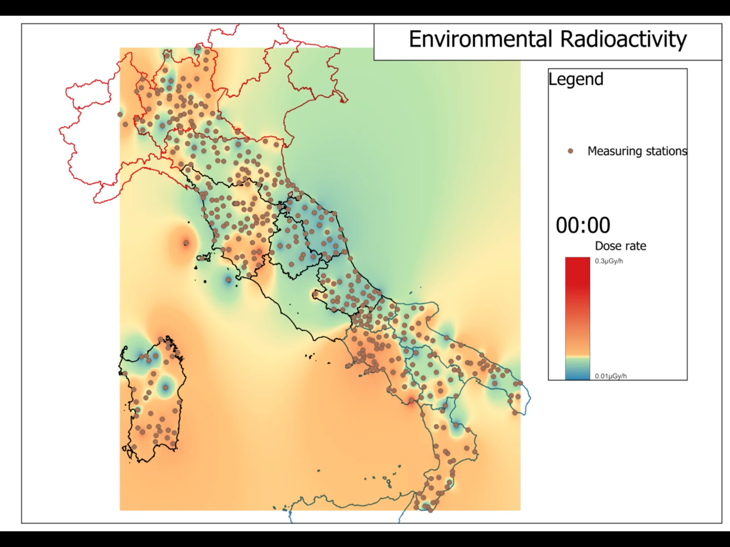
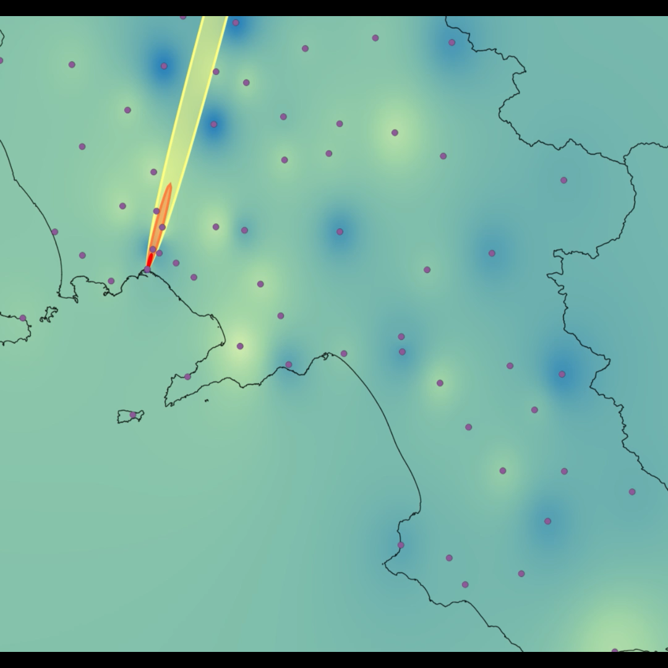
Impact Stories – Seven AI Use Cases
USE CASE 2: AI-Powered Decision Support in CBRN Incidents
  Ex. 3 – University of Rome Tor Vergata – Prof. Malizia, Dr. Quaranta

Slide 24

Impact Stories – Seven AI Use Cases
USE CASE 3: Simulation-Based CBRNe Training with AI
KEY POINTS
  AI creates adaptive, realistic virtual training scenarios.
  Enhances responder readiness.
  BENEFITS
  Reduces need for high-risk live exercises
  Scalable across organizations
Full video: https://www.youtube.com/watch?v=R6rmYpQGfaI
https://www.mdpi.com/2414-4088/7/9/88

Slide 25
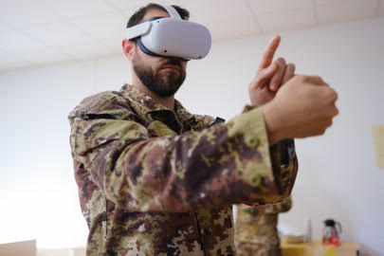
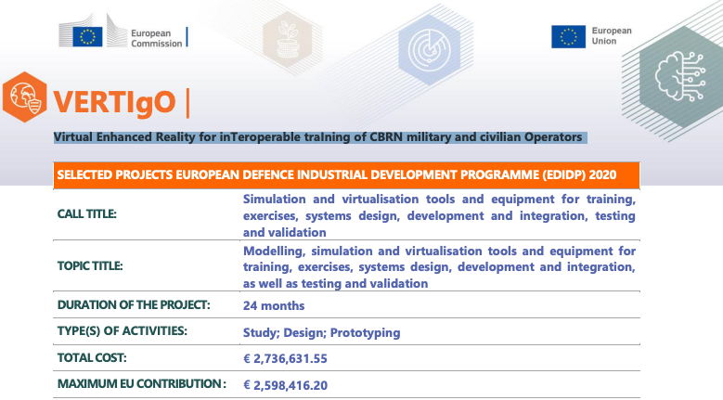
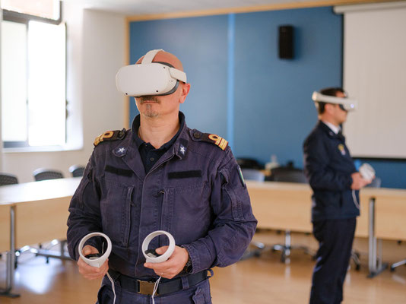
Impact Stories – Seven AI Use Cases
USE CASE 3: Simulation-Based CBRNe Training with AI
  Ex. 1 – Virtual Enhanced Reality for inTeroperable traIning of CBRN military and civilian Operators
https://www.cbrngate.com/2024/05/13/project-vertigo-closing-event/
https://defence-industry-space.ec.europa.eu/system/files/2021-06/EDIDP2020_factsheet_SVTE_VERTIGO.pdf

Slide 26
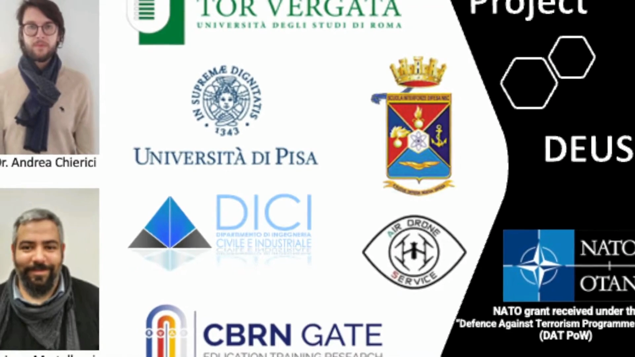
Impact Stories – Seven AI Use Cases
USE CASE 4: Autonomous Drones for CBRN Detection
KEY POINTS
  Deployed in contaminated zones
  Collect real-time data safely
  BENEFITS
  Reduced responder exposure
  Integration with AI: Mapping, plume tracking
Full video: https://www.youtube.com/watch?v=BXaAUmS5Lqg&t=62s

Slide 27
Impact Stories – Seven AI Use Cases
USE CASE 4: Autonomous Drones for CBRN Detection
  Ex. 1 – University of Rome Tor Vergata. Prof. Gaudio, Dr. Martellucci, Dr. Chierici, Dr. Di Giovanni, Dr. Rossi
Chierici A., MALIZIA A, Di Giovanni D., Ciolini R., d'Errico F. (2022). A High- Performance Gamma Spectrometer for Unmanned Systems Based on Off-the- Shelf Components. SENSORS, vol. 22, 1078, ISSN: 1424-8220, doi: 10.3390/s22031078
Chierici A., MALIZIA A, Di Giovanni D., Fumian F., Martellucci L., Gaudio P., d'Errico F. (2021). A low-cost radiation detection system to monitor radioactive environments by unmanned vehicles. THE EUROPEAN PHYSICAL JOURNAL PLUS, vol. 136, 314, ISSN: 2190-5444, doi: 10.1140/epjp/s13360- 021-01276-4
Marturano F., Ciparisse J.-F., Chierici A., d’Errico F., Di Giovanni D., Fumian F., Rossi R., Martellucci L., Gaudio P., MALIZIA A (2020). Enhancing radiation detection by drones through numerical fluid dynamics simulations. SENSORS, vol. 16, 1770, ISSN: 1424-8220, doi: 10.3390/s20061770
Carminati, G, MALIZIA A, d’Errico, F, Gaudio, P (2021). Design of Miniaturized Sensors for a Mission-Oriented UAV Application: A New Pathway for Early Warning. INTERNATIONAL JOURNAL OF SAFETY AND SECURITY ENGINEERING, vol. 11, p. 435-444, ISSN: 2041-9031, doi: 10.18280/ijsse.110417
Martellucci, L., Chierici, A., Di Giovanni, D., Fumian, F., MALIZIA A, Gaudio, P. (2021). Drones and sensors ecosystem to maximise the storm effects in case of cbrne dispersion in large geographic areas. INTERNATIONAL JOURNAL OF SAFETY AND SECURITY ENGINEERING, vol. 11, p. 377- 386, ISSN: 2041-9031, doi: 10.18280/ijsse.110411

Slide 28
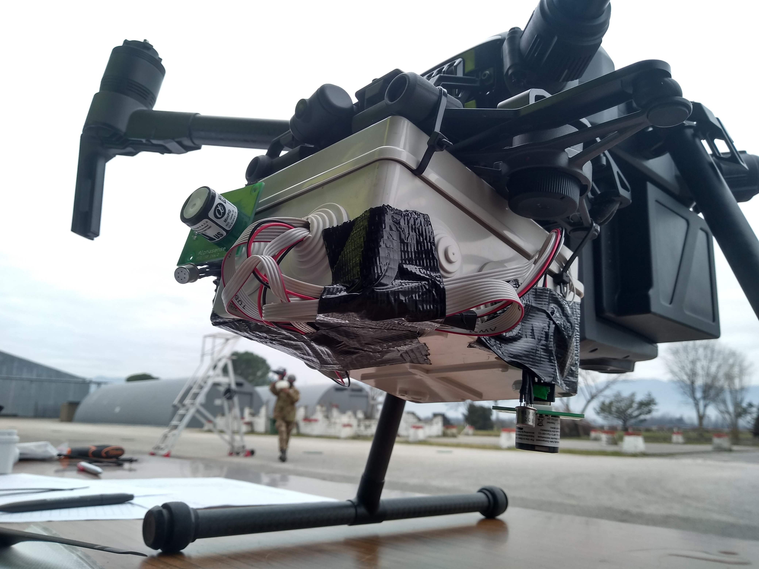
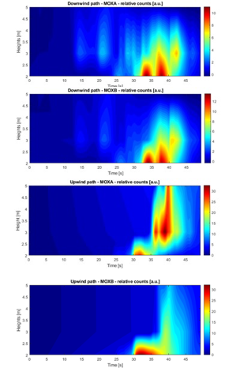
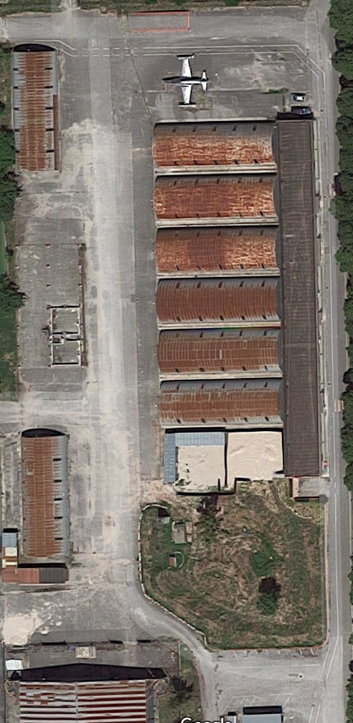
Impact Stories – Seven AI Use Cases
USE CASE 4: Autonomous Drones for CBRN Detection
  Ex. 1 – University of Rome Tor Vergata. Prof. Gaudio, Dr. Martellucci, Dr. Chierici, Dr. Di Giovanni, Dr. Rossi
front pid/mox
nadir pid/mox
40 m
Fly area
emission point 1
take off
landing
emission point 2

Slide 29
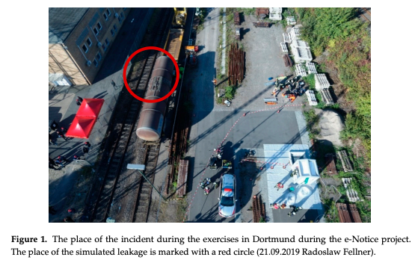
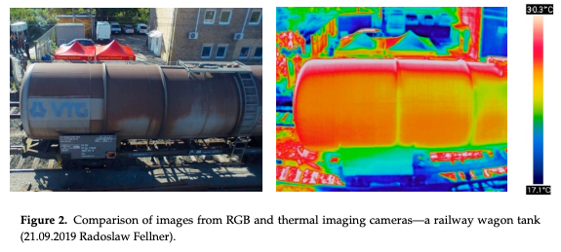
Impact Stories – Seven AI Use Cases
USE CASE 4: Autonomous Drones for CBRN Detection
  Ex. 2 – Monitoring of Selected CBRN Threats in the Air in Industrial Areas with the Use of Unmanned Aerial Vehicles
https://www.h2020-enotice.eu/
https://www.mdpi.com/2073-4433/11/12/1373

Slide 30
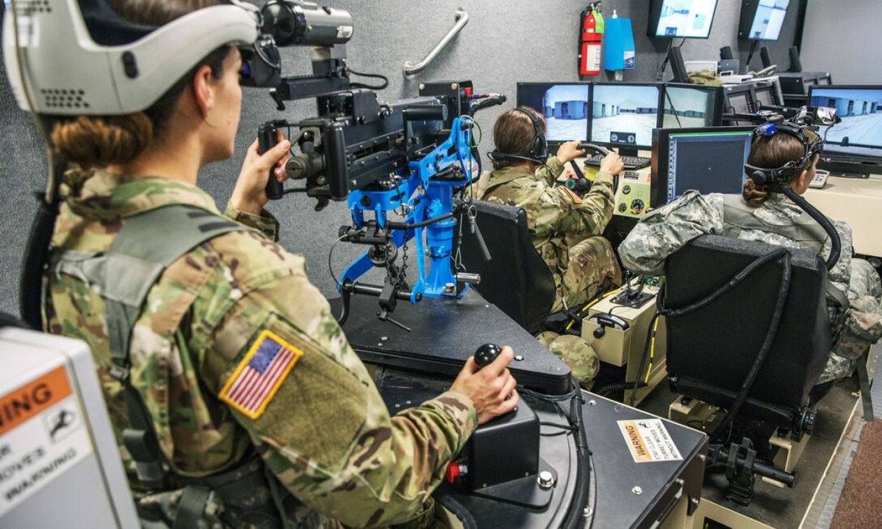
Impact Stories – Seven AI Use Cases
USE CASE 5: AI in Military Training Simulators
KEY POINTS
  Adaptive combat simulations
  Prepares soldiers for complex threats
  BENEFITS
  Enhanced situational judgment
  Increased retention of protocols
https://www.czdefence.com/article/artificial-intelligence-in-combat-simulations-how-ai-is-changing-nato-and-czech-army-soldier-training

Slide 31
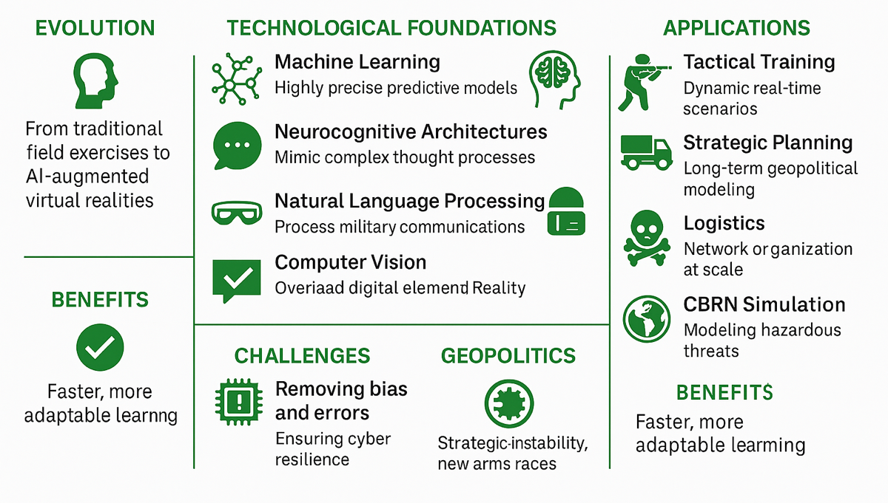
Impact Stories – Seven AI Use Cases
USE CASE 5: AI in Military Training Simulators
  Ex. 1 – Artificial Intelligence in combat simulations: How AI is changing NATO and Czech Army soldier training
https://www.czdefence.com/article/artificial-intelligence-in-combat-simulations-how-ai-is-changing-nato-and-czech-army-soldier-training

Slide 32
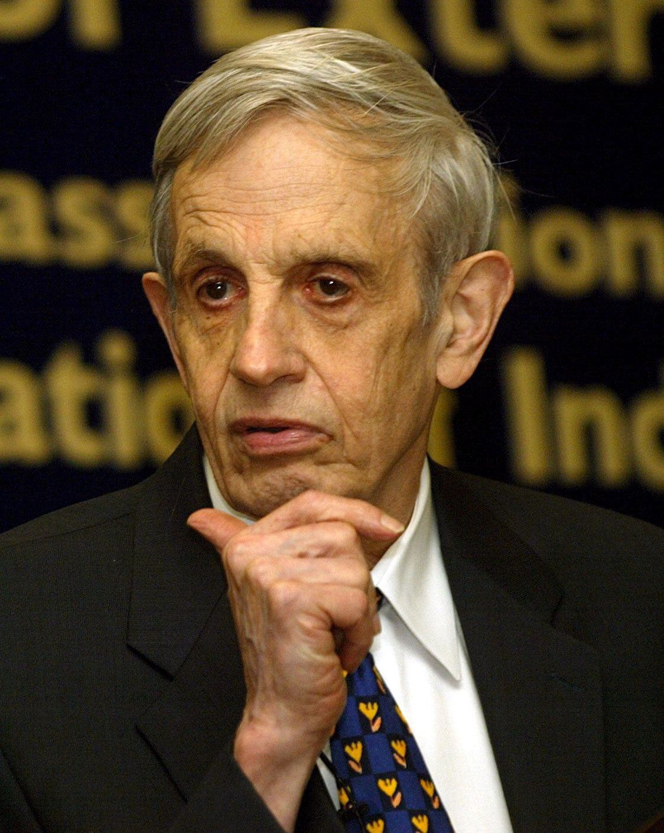
Impact Stories – Seven AI Use Cases
USE CASE 6: AI Risk Management in CBRNe Systems
KEY POINTS
  Ethical AI deployment
  Safety testing and scenario modeling
  BENEFITS
  Bias, explainability, dual-use risks
  Need for cross-sectoral standards
https://link.springer.com/chapter/10.1007/978-3-319-91791-7_22

Slide 33
Impact Stories – Seven AI Use Cases
USE CASE 6: AI Risk Management in CBRNe Systems
  Ex. 1 – University of Rome Tor Vergata. Prof. Malizia, Dr. Iannotti, Dr. Rossi
The integration of artificial intelligence (AI) into game theory offers a novel approach to addressing the challenges of safety and security in a complex global environment.
Given the strategic implications of CBRN, AI-enhanced game theory can provide valuable insights for policymakers, enabling them to make more informed decisions by anticipating the actions of adversaries and evaluating potential outcomes.
https://link.springer.com/chapter/10.1007/978-3-319-91791-7_22

Slide 34
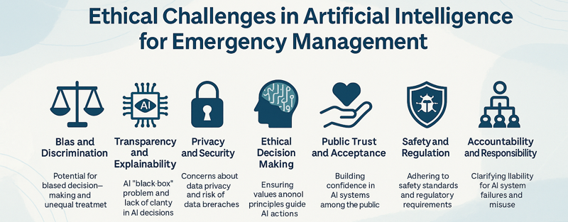
Impact Stories – Seven AI Use Cases
USE CASE 6: AI Risk Management in CBRNe Systems
  Ex. 2 – AI in Emergency Management: Ethical Considerations and Challenges
https://www.worldscientific.com/doi/10.1142/S268998092450009X
Image generated with ChatGPT 4o

Slide 35
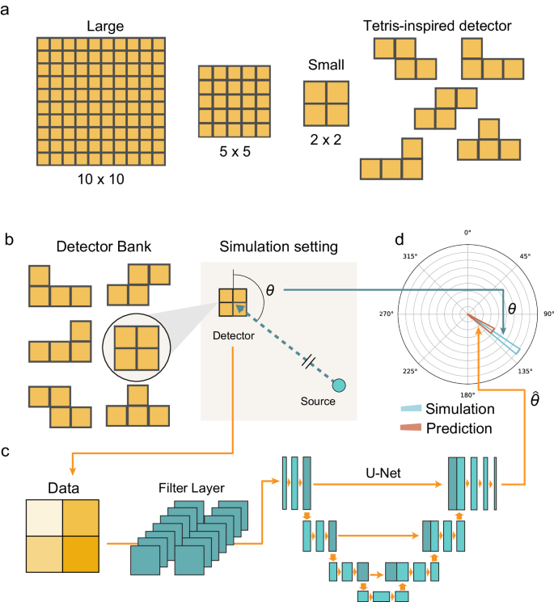
Impact Stories – Seven AI Use Cases
USE CASE 7: AI in Threat Detection Systems
KEY POINTS
  Real-time scanning and alerts
  Integration with public safety infrastructure
  BENEFITS
  Faster alerting
  Reduced false positives
https://www.nature.com/articles/s41467-024-47338-w

Slide 36


Impact Stories – Seven AI Use Cases
USE CASE 7: AI in Threat Detection Systems
  Ex. 1 – Tetris-inspired detector with neural network for radiation mapping
Image generated with ChatGPT 4o
https://www.nature.com/articles/s41467-024-47338-w

Slide 37

Impact Stories – Seven AI Use Cases
USE CASE 7: AI in Threat Detection Systems
  Ex. 2 – Artificial Intelligence in Cybersecurity Threat Detection
Image generated with ChatGPT 4o
https://wepub.org/index.php/IJCSIT/article/view/3521

Slide 38

Impact Stories – Seven AI Use Cases
USE CASE 7: AI in Threat Detection Systems
  Ex. 3 – How one company is using AI to transform manufacturing
https://www.weforum.org/stories/2024/01/company-using-ai-transform-manufacturing-business/

Slide 39


AI – Communication
Courtesy of Dr. Antonio Parrilla – Italian Prime Ministry Office
Full interview: https://www.youtube.com/watch?v=T5ko9-Aflc0&t=2913s

Slide 40

AI – Communication
Full video: https://www.youtube.com/watch?v=gLoI9hAX9dw&t=28s

Slide 41

Risk, Governance and Responsible AI
Image generated with ChatGPT 4o

Slide 42


Conclusion – 1/4
Education, training and research are key aspects
Multidisciplinary training for scientists, military, civil responders
Upskilling in AI ethics, modeling, and simulation
Investing in young professionals through CBRNe-focused AI programs
AI can be just a «COPILOT», our competences mark the differences in science
https://www.researchgate.net/publication/250290986_Building_Management_and_ICT_Learning_in_Civil_Engineering_Education/figures?lo=1
https://www.mdpi.com/2227-7102/13/3/269

Slide 43



Conclusion – 2/4
https://www.sicc-series.com/
https://www.cbrngate.com/

Slide 44

Conclusion – 3/4
“For every new activity, technology, or discovery, we must assess the potential for malicious dual use — that is, the risk that it could be misused for military purposes or exploited in the civilian sector for acts of terrorism or sabotage — and develop appropriate strategies for prevention, countermeasures, responsible development, and emergency management to minimize associated risks.”
Transformation towards sustainable and resilient societies in Asia and the Pacific
https://www.researchgate.net/publication/324216809_Transformation_towards_sustainable_and_resilient_societies_in_Asia_and_the_Pacific/figures?lo=1

Slide 45
Conclusion – 4/4
AI is no longer optional It is essential for facing modern CBRNe threats – chemical design, bioweapons, radiological sabotage, nuclear command risks.
AI Use Cases show real impact:
Safer chemical plants
Smarter biothreat simulations
Drone-based radiation mapping
AI-enhanced decision systems
Deep learning in virology outperforms experts
Global cooperation is vital: CBRNe challenges cross borders — so must solutions. Support UNICRI, NATO, OPCW, EU, DHS frameworks.
Roadmap to 2035 starts now: Embed AI safely and strategically. Every actor counts.

Slide 46
Enhancing CBRNe Security through Artificial Intelligence: Detection, Simulation, and
Decision-Making
Andrea Malizia^{1,2}, Luca Martellucci^{2,3}, Alessandro Puleio ^{2,3},
Riccardo Rossi^{2,3}, Alba Iannotti^{2,3,4}, Riccardo Quaranta^{1,2,3},
Colomba Russo^{2,3,4}, Daniele Di Giovanni^{1,2}, Grace P. Xerri^{2,3},
Gabriele Giuga^{2,3}, Sabrina Rao^{1,2} and Pasquale Gaudio^{2,3}
1. Department of Biomedicine and Prevention, University of Rome Tor Vergata (Italy)
2. International Master Courses in Protection against CBRNe events, University of Rome Tor Vergata (Italy)
3. Department of Industrial Engineering, University of Rome Tor Vergata (Italy)
4. HESAR s.r.l.s, (Italy)
The EU CBRN Risk Mitigation Centres of Excellence Initiative
10th International Meeting of the National Focal Points
14-15 May 2025, Egmont Palace – Brussels (Belgium)

